Slide 1
Inferring retinal cell types from efficient coding principles
Preliminary exam for David St-Amand
Notes:
Talk about cell types
5 criteria, we’re especially interested into function
Retina is a great place to study that

Slide 2
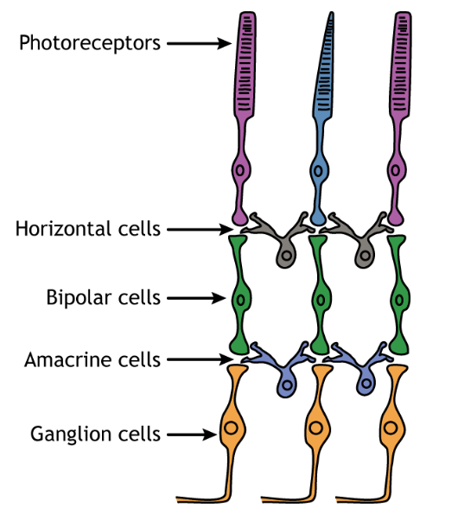
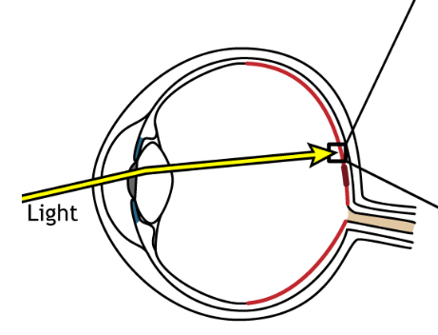
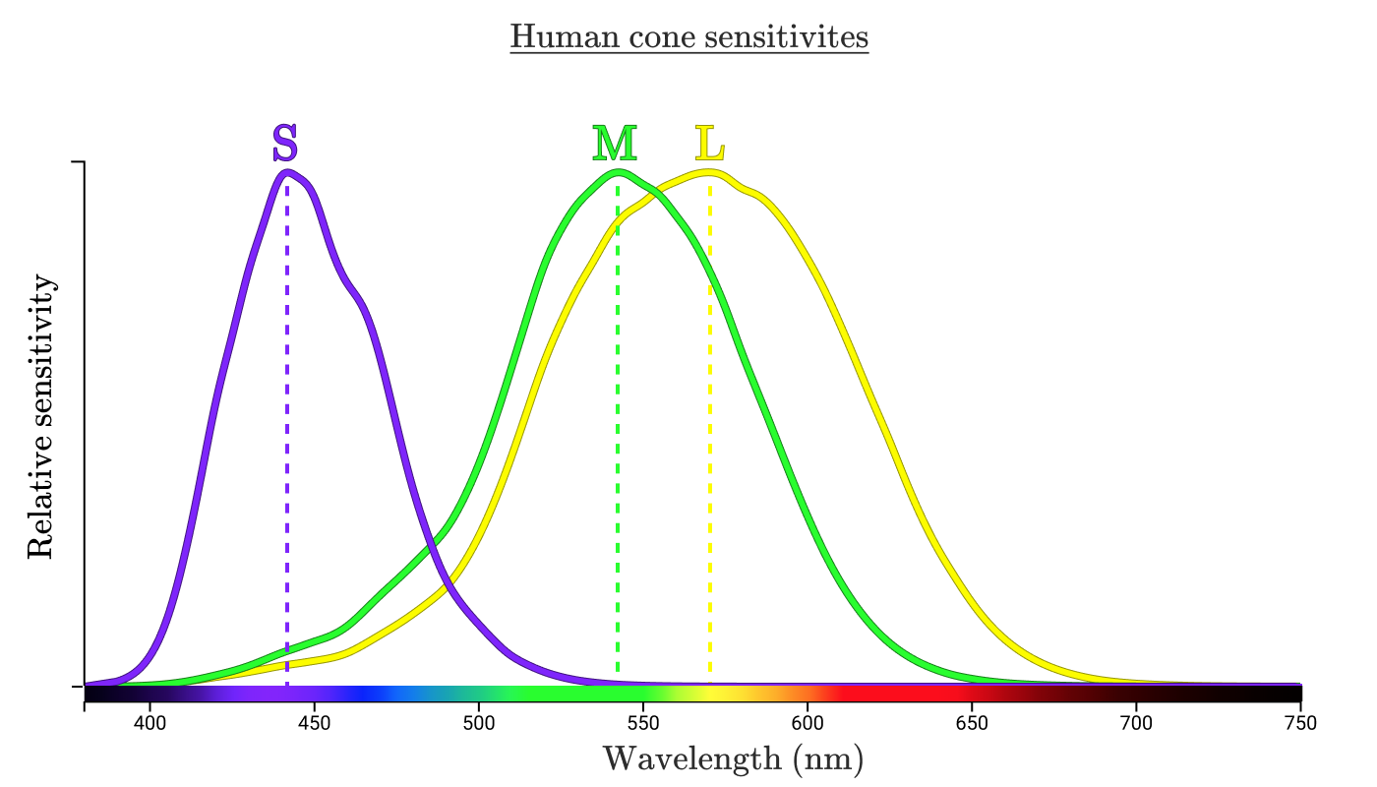
The retina is well-structured into different cell types
Notes:
Retina is a great place to study the functional role of cell types, since we have direct control of the inputs

Slide 3
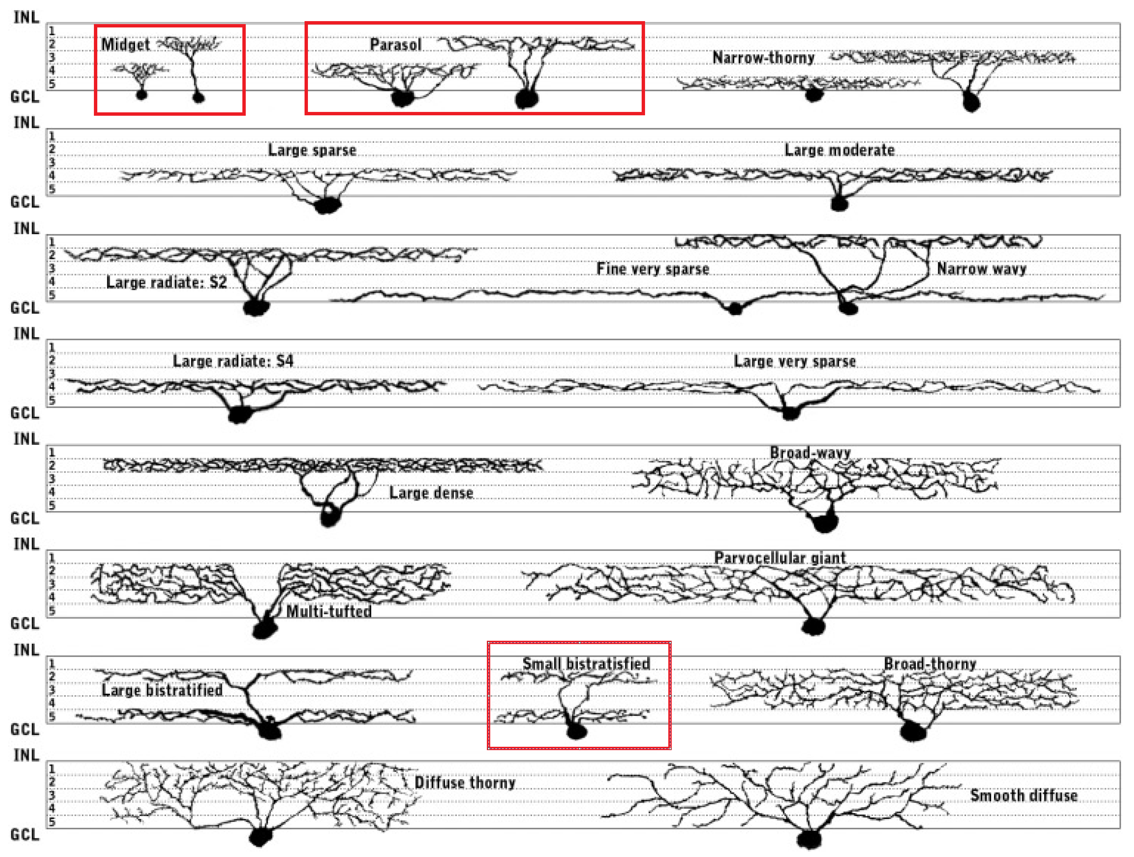
Retinal ganglion cells have many cell types
Yamada, Bordt & Marshak, 2004

Slide 4
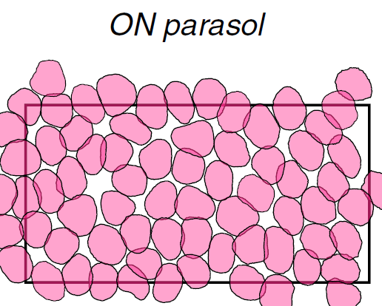
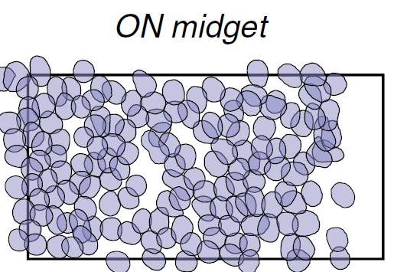
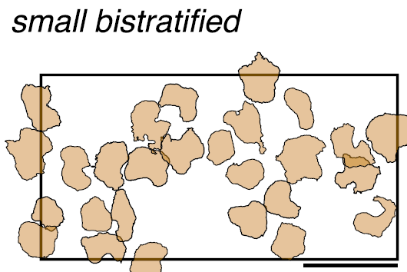
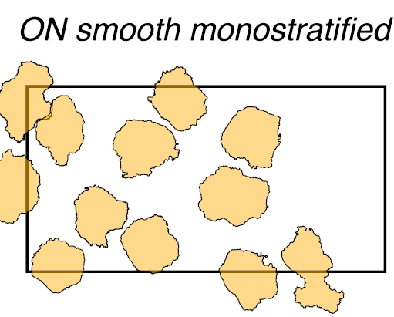
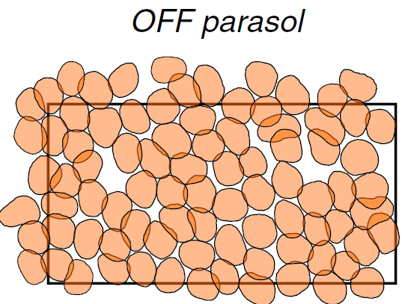
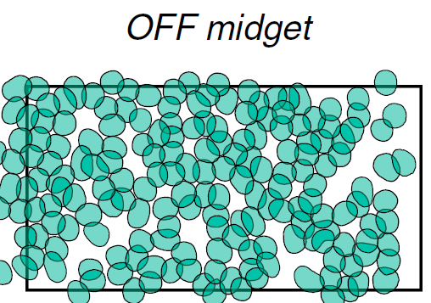
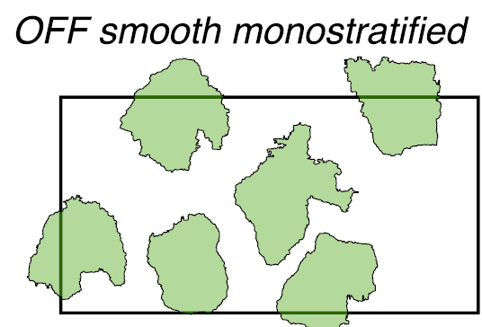
Parasol, midget and bistratified cells are the most prevalent cell types
Rhoades et al., 2019

Slide 5
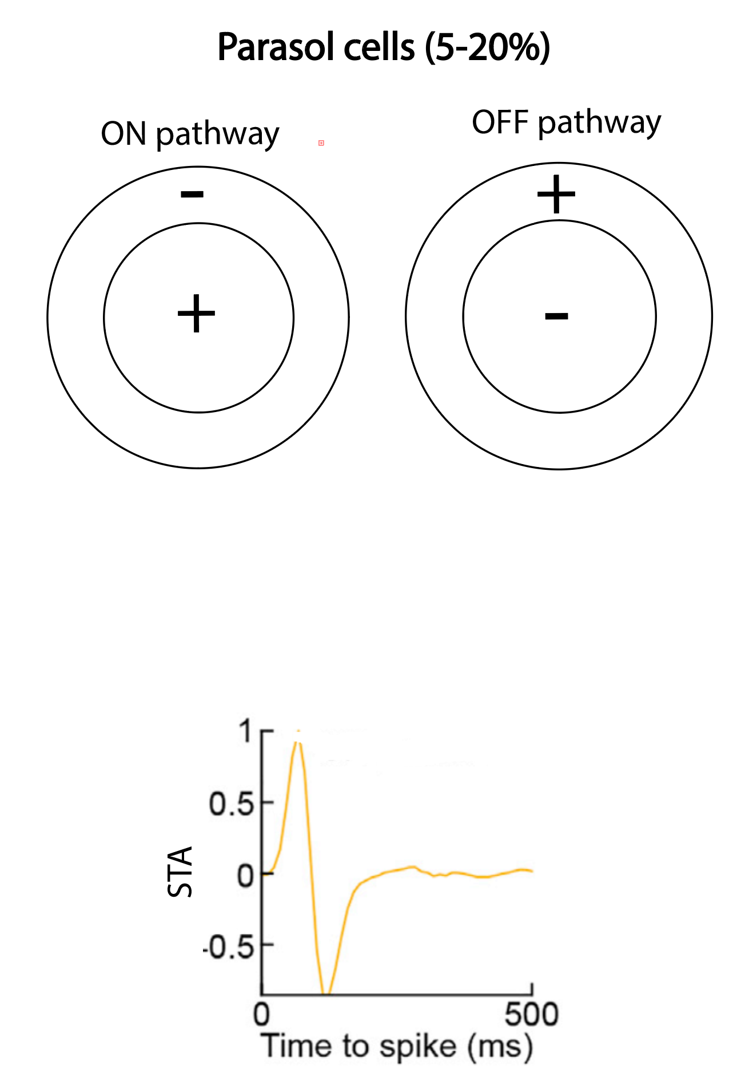
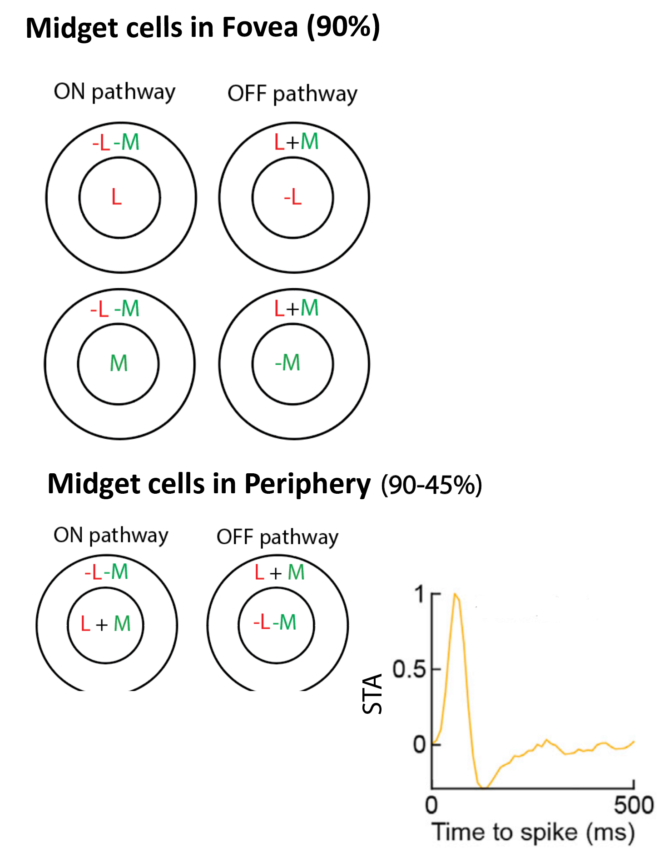
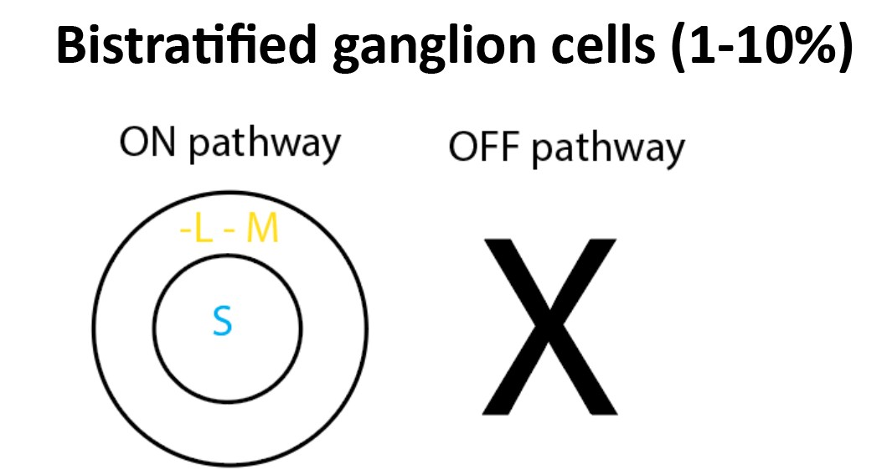
Properties of 3 major cell types

Slide 6
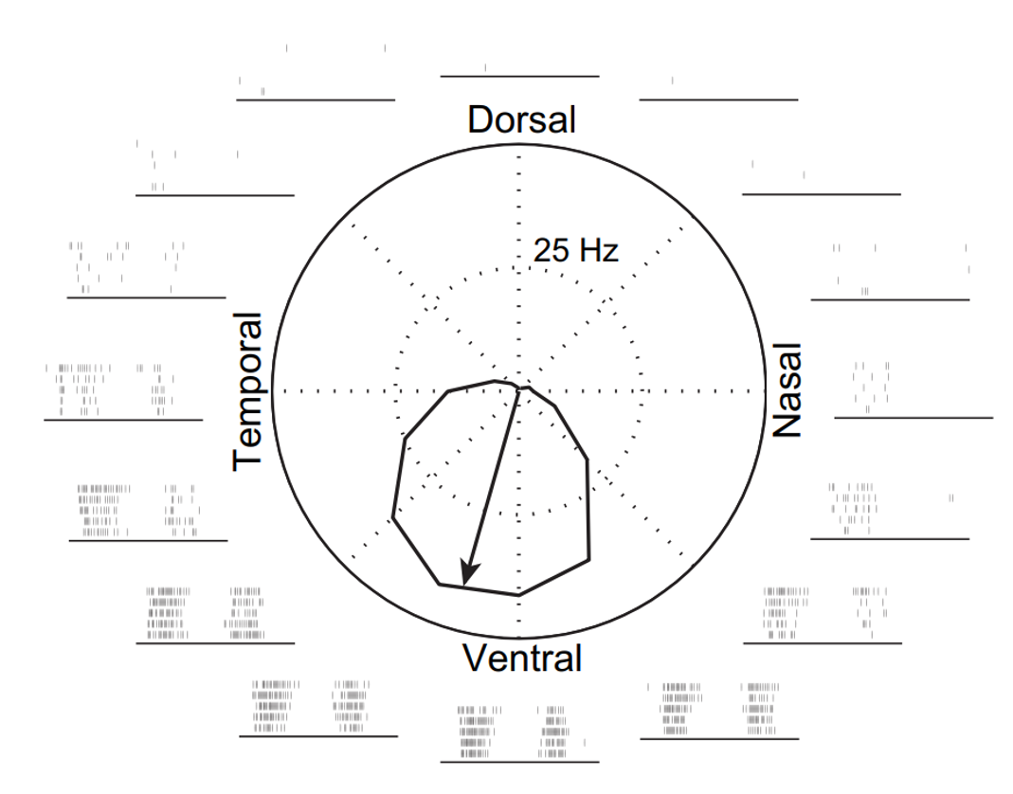
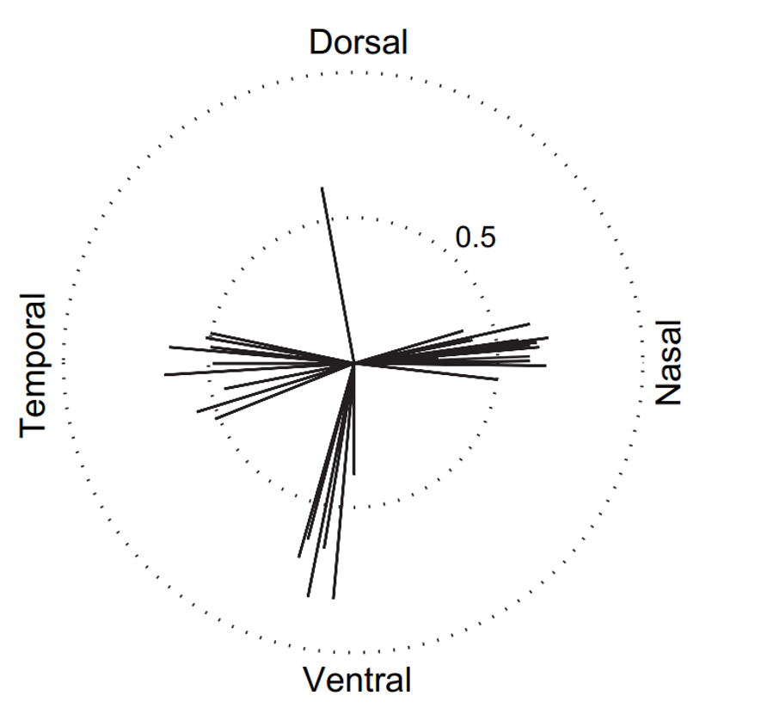
Direction-selective ganglion cells
Elstrott et al., 2008
Notes:
Transition to EC: Why these cell types?
I want to talk about an idea that has been capable of explaining properties of RGCs and that has the potential to answer this question

Slide 7
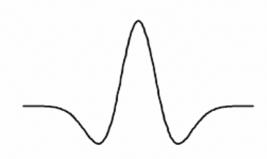
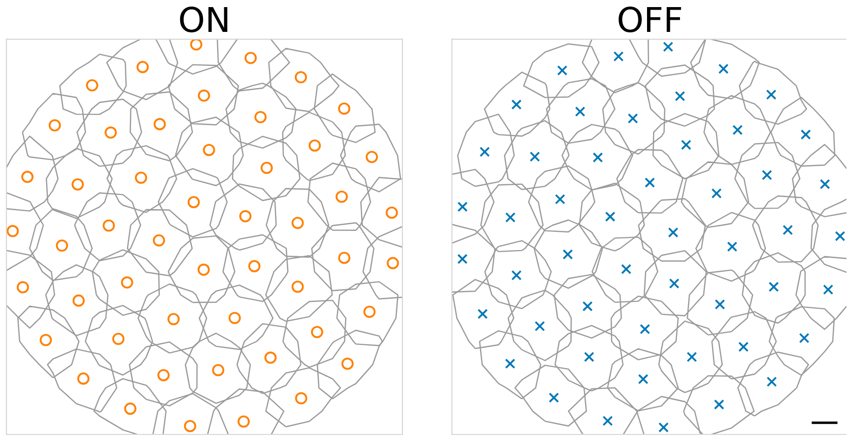
Efficient coding hypothesis
Sensory systems try to maximize information within biological constraints
(e.g. energy, number of cells, etc)
Solution: Mosaics of center-Surround receptive fields
Notes:
Explain alternatives (predictive coding, sparse coding)

Slide 8
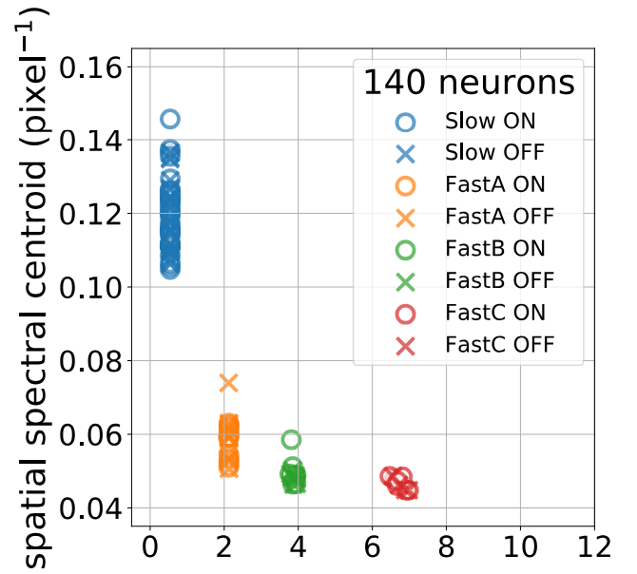
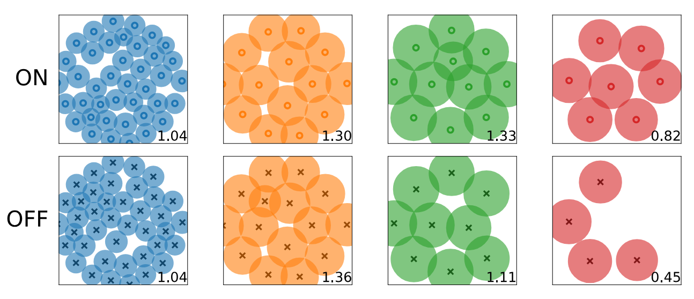
The spatiotemporal properties of midget and parasol cells can be explained by efficient coding
Jun, Field & Pearson, 2022
Notes:
Remove model
Only stick to the core idea: We vary number of cells, and they automatically clustered into types
Tradeoff between SF and TF

Slide 9
Successes of efficient coding
What can be explained by efficient coding:
Center-surround receptive fields¹
Separation of early vison into ON and OFF pathways²
Organization of cells into mosaics³
Anti-alignment of ON and OFF mosaics⁴
Tradeoff of encoding spatial and temporal frequencies by midget and parasol cells^{5,6}
What has yet to be explained by efficient coding:
How different cell types encode color inputs
Direction-selective ganglion cells
¹Atick, Li & Redlich, 1990; ²Gjorgjieva, Sompolinsky, & Meister, 2014; ³Zang, Wei & Simoncelli, 2018; ⁴Jun, Field & Pearson, 2021; ⁵Ocko et al., 2018; ⁶Jun, Field & Pearson, 2022
Notes:
Greg: Remove color opponency from this
Remove literature
Have a list of bullets about what it doesn’t explain****
Have references at the very bottom, out of the way

Slide 10
Aims of the proposal
Aim 1: Can efficient coding predict color coding by cell types?
Aim 2: Can efficient coding explain direction-selectivity in RGCs ?

Slide 11
Aim 1: Can efficient coding predict color coding by cell types?
Puzzle #1: Bistratified cells are the only type to have an ON but not an OFF pathway. What properties of natural images give rise to this asymmetry?
Puzzle #2: Midget cells are more prevalent, and process color differently, in the fovea than in the periphery. Is this difference due to a higher number of neurons in the fovea?
Notes:
Maybe show this at the end. This feels like a summary slide.

Slide 12
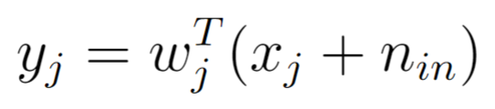
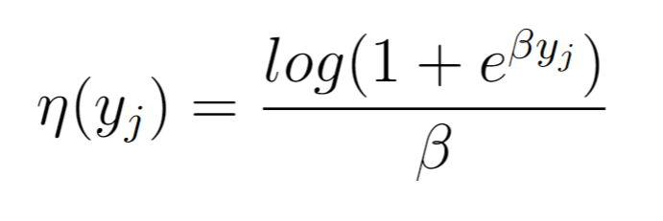
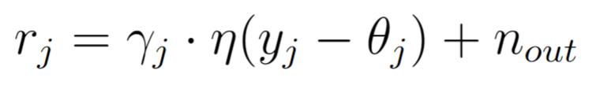
Efficient coding model
1- Linear weighted inputs
2- Softplus output nonlinearity
3- Gain and threshold

Slide 13
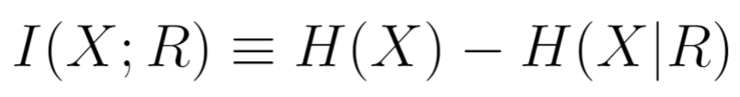
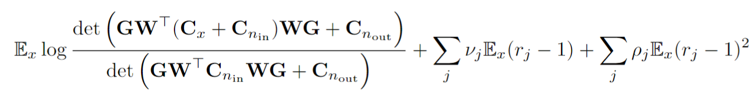
Maximizing mutual information
Mutual information:
Closed-form approximation:
Notes:
Might remove this slide, think about it

Slide 14
Expected outcomes
#1. Neurons should cluster into 6 mosaics that have receptive field properties similar to midget, parasol and bistratified cells.
#2. We should be able to increase or decrease the asymmetry in bistratified cells by changing the statistics of natural images
#3. Increasing the number of neurons should increase the prevalence of midget cells as well the red/green opponency of their receptive fields.
Notes:
#1 Efficient coding predictions, we’ll know how well efficient coding works for cell types
We’ll also develop a mathematical understanding of why #1 works or doesn’t work

Slide 15
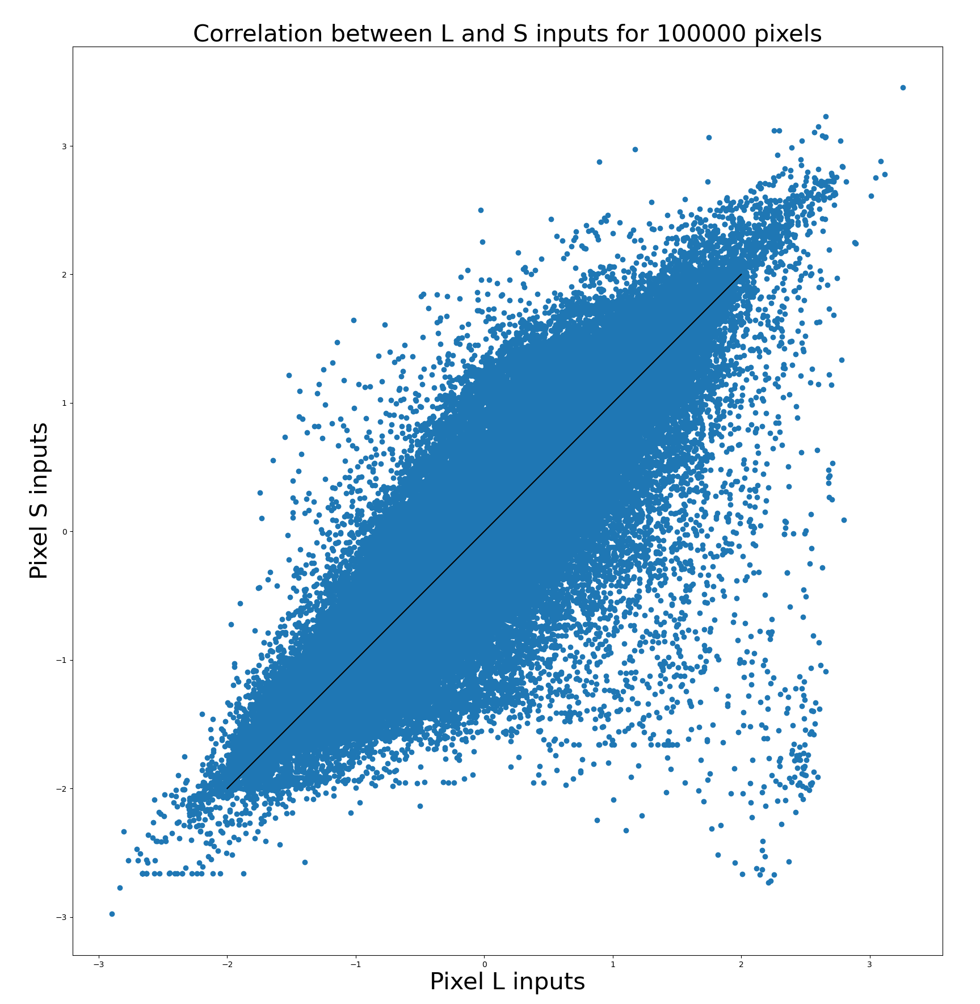
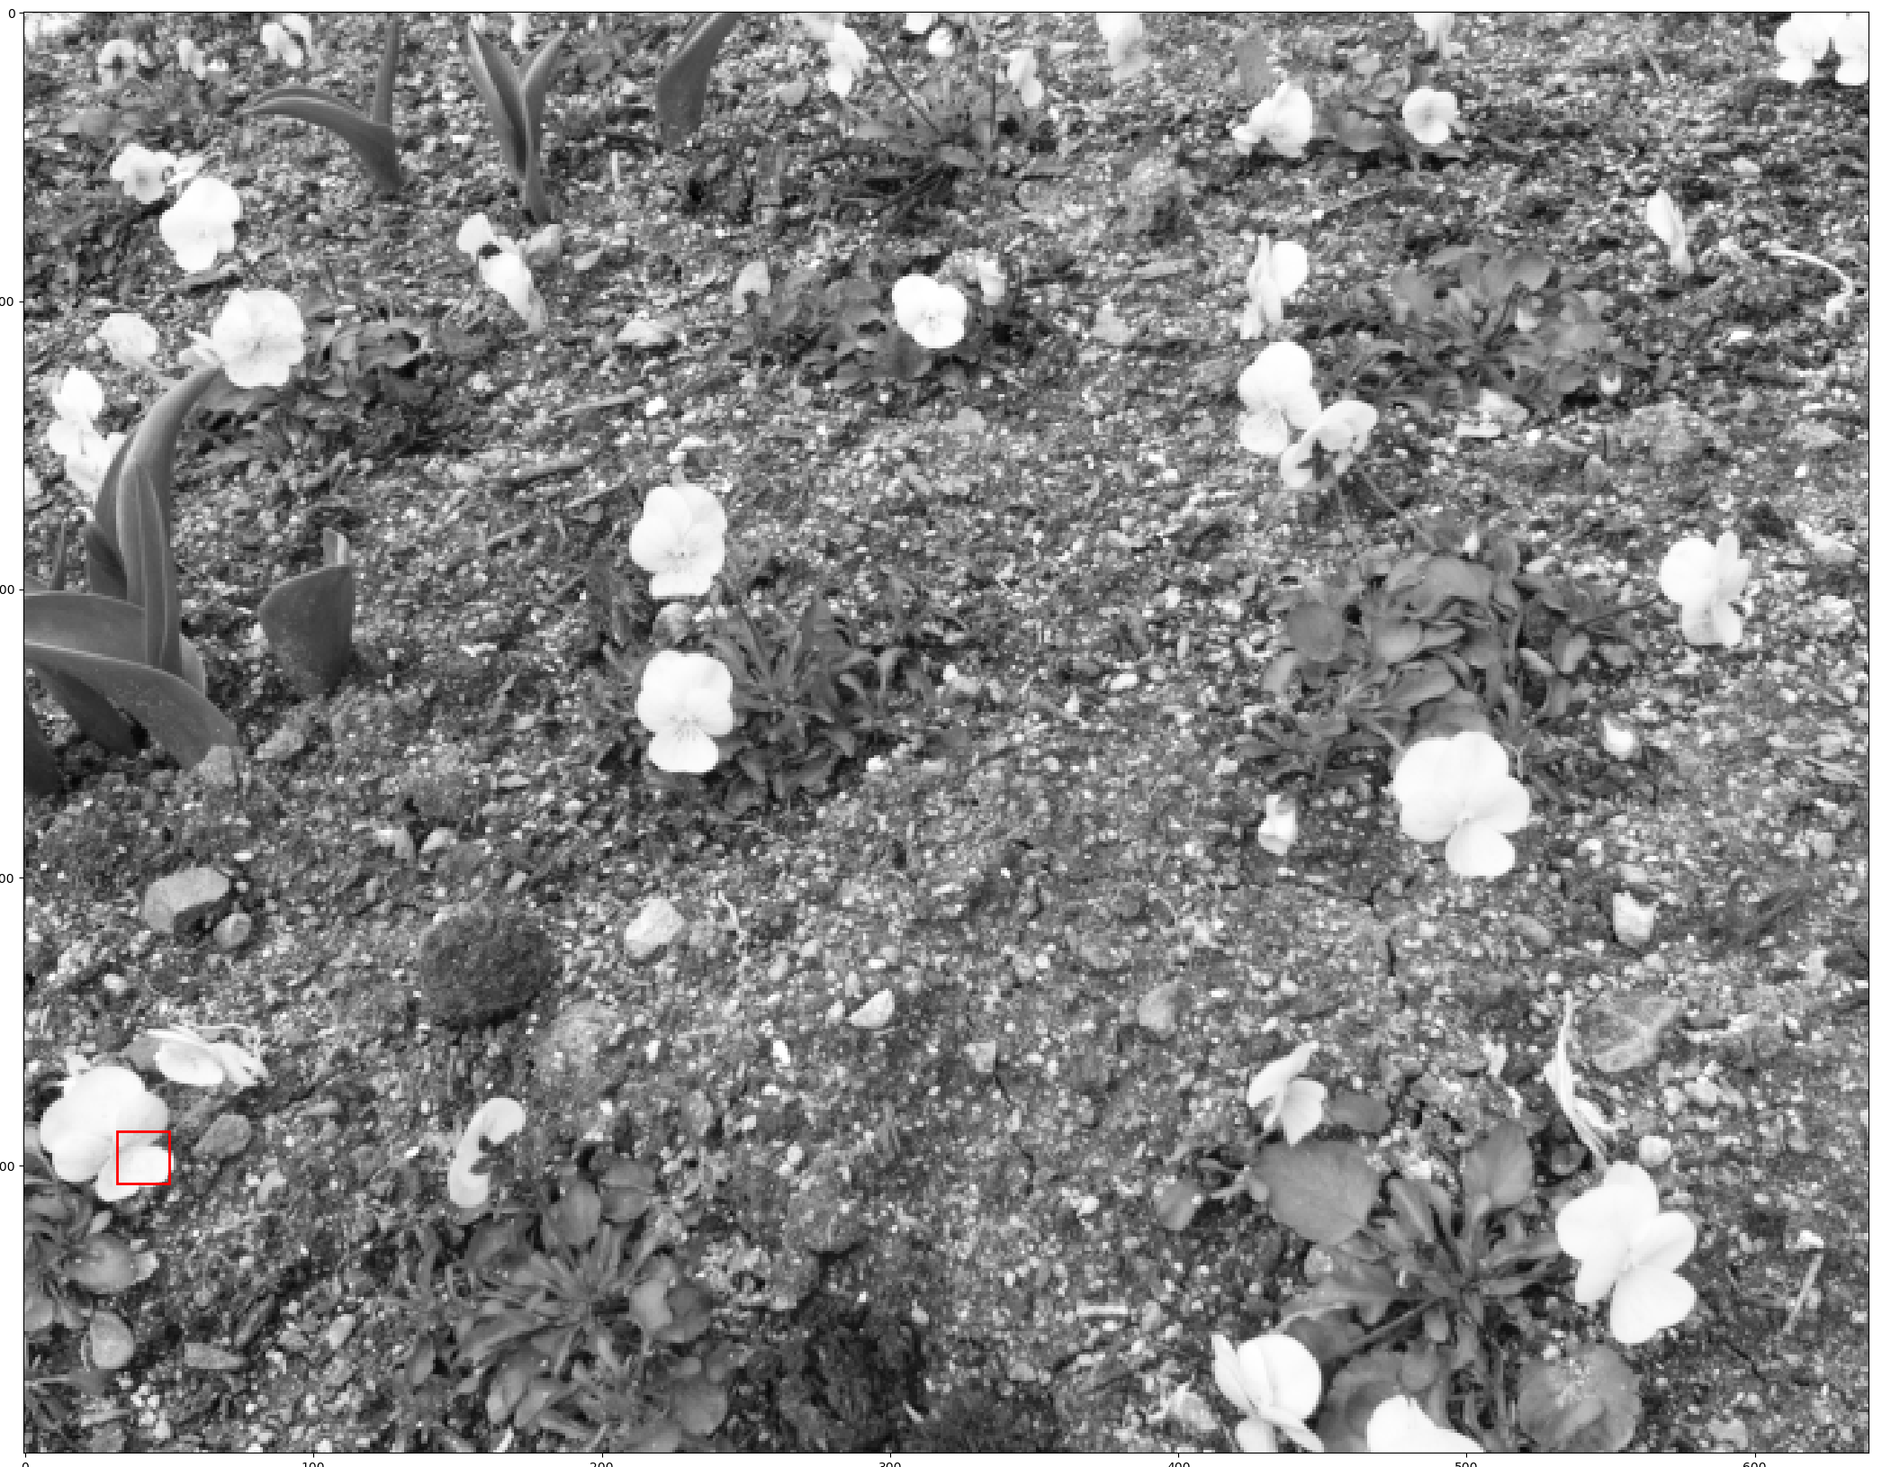
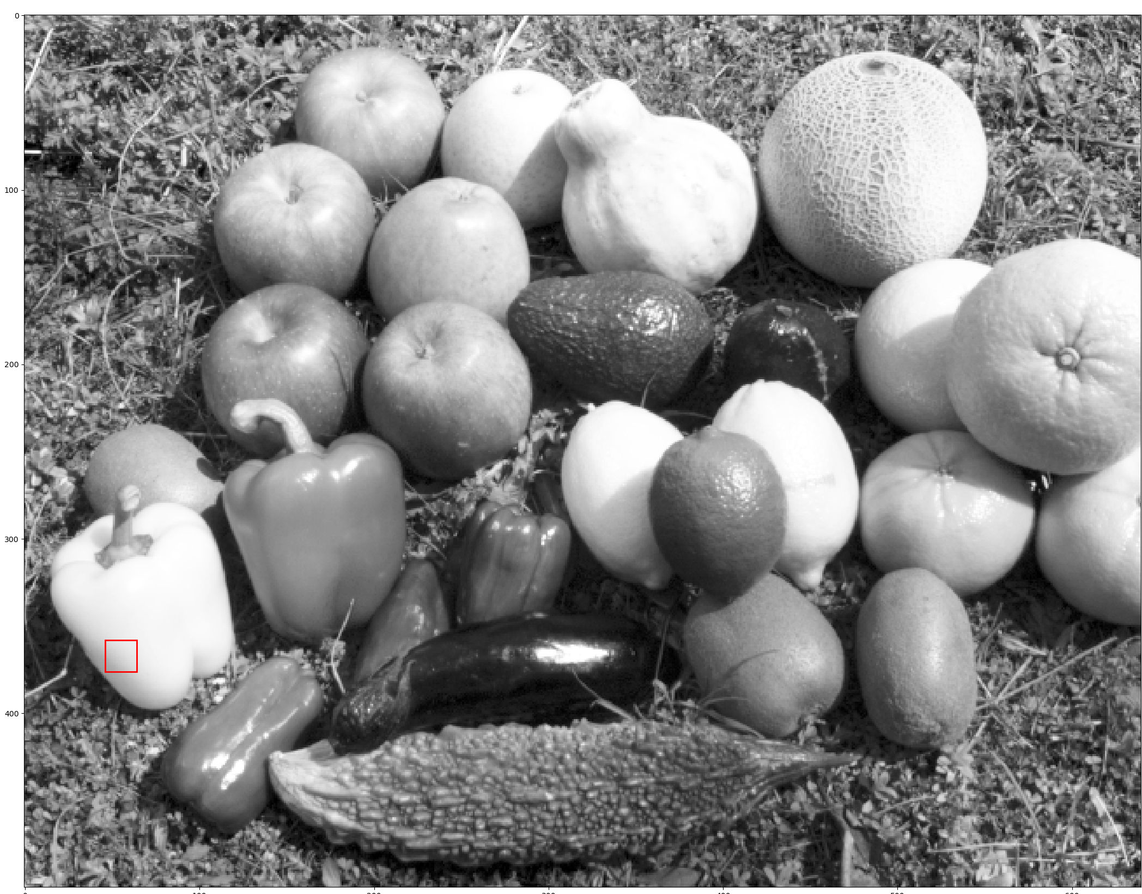
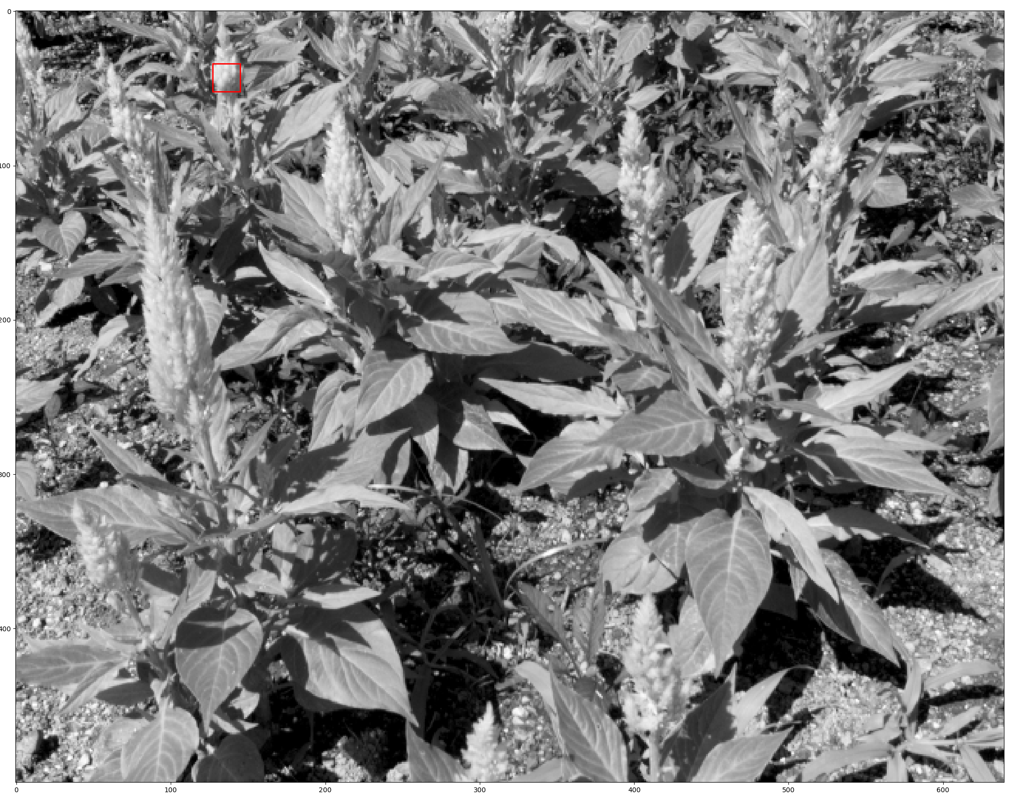
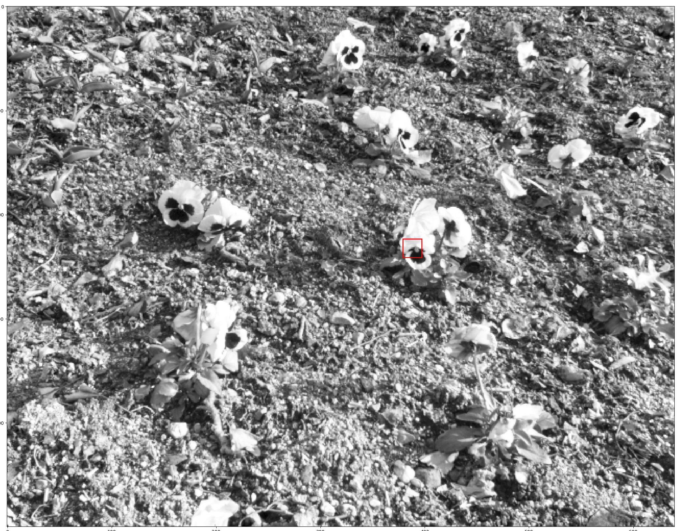
Simulated L and S cone responses have asymmetric natural image statistics

Slide 16
Aim 2: Can efficient coding explain direction-selectivity in RGCs ?
Puzzle #1: Why are only a fraction of RGCs direction-selective, despite the prevalence of motion in natural movies?
Puzzle #2: Why do ON-OFF DSGCs only encode the four cardinal directions?
Is this due to a property of optic flow or motion in the natural world?

Slide 17
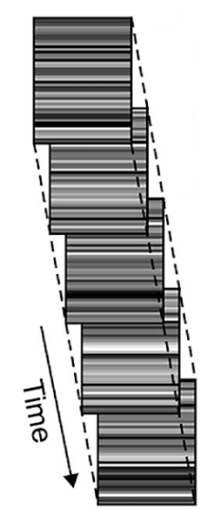
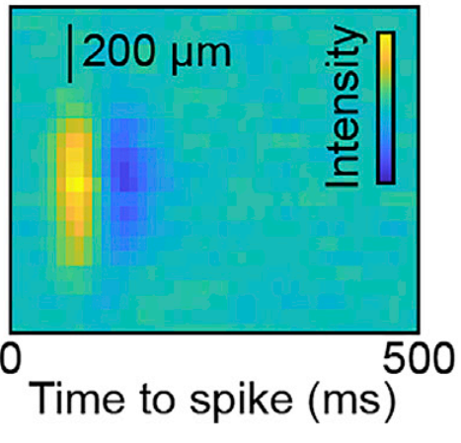
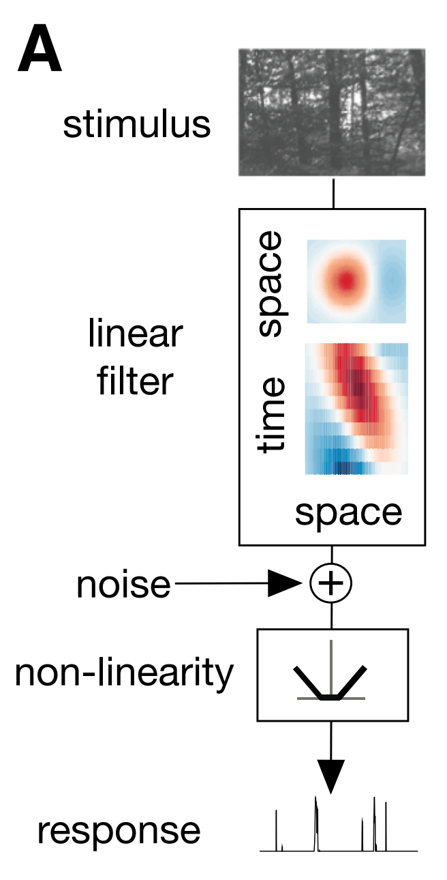
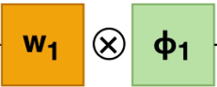



DSGCs have tilted RFs in space-time
Stimuli
Parasol and midget cells
ON-OFF Direction-selective ganglion cells
Space
Cafaro, Zylberberg & Field, 2007
Soto et al., 2020
Notes:
Remove the junk around the stimuli

Slide 18
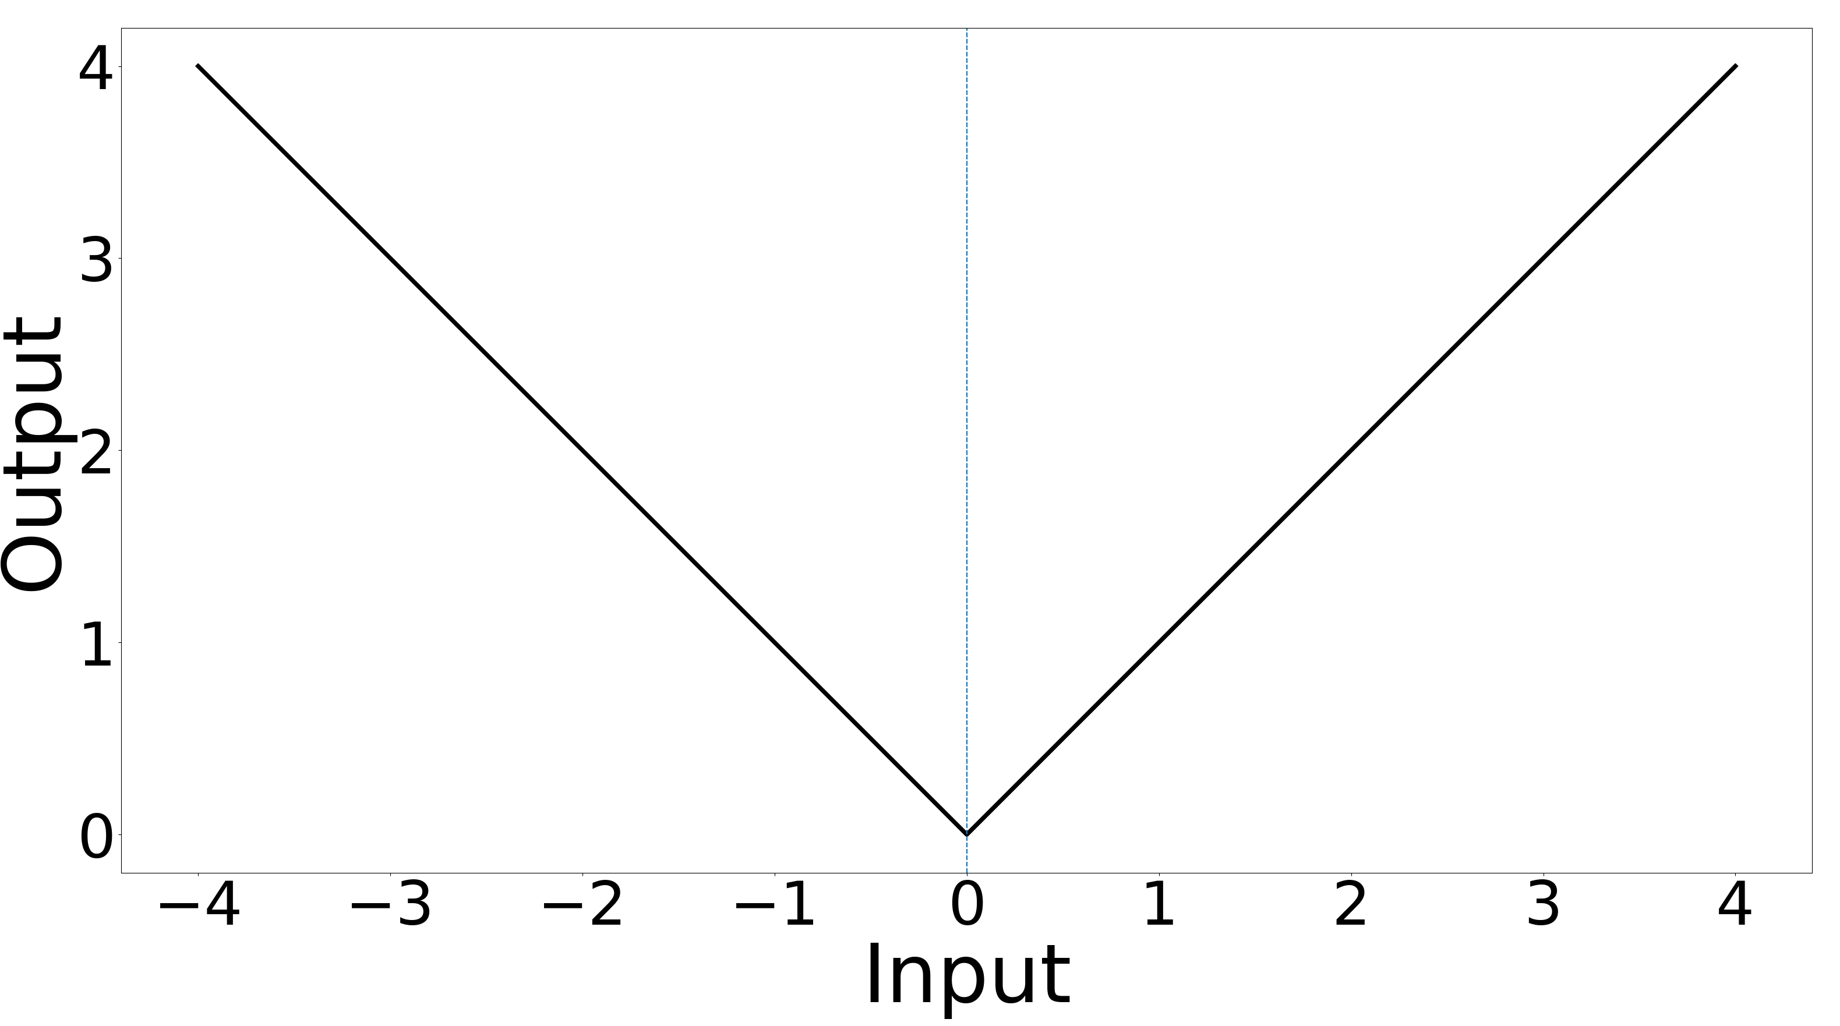
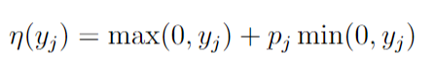
Efficient coding for space-time inseparable receptive fields
Parametrized rectified nonlinearity
Notes:
Thing in the middle in previous slide

Slide 19
Expected outcomes
#1. Most neurons should not be direction-selective, but have spatiotemporal properties similar to parasol and midget cells.
#2. We should get mosaics of DSGCs that encode the four cardinal directions.
#3. The prevalence of DSCGs and their properties should change as we change the statistics of natural movies.

Slide 20
Summary
Aim 1: Can efficient coding predict color coding by cell types?
Puzzle 1: Why do bistratified cells have an ON but not an OFF pathway?
Puzzle 2: Why do the properties of midget cells change so much between the fovea and periphery?
Aim 2: Can efficient coding explain direction-selectivity in RGCs ?
Puzzle 1: Why only a fraction of RGCs are direction-selective?
Puzzle 2: Why do ON-OFF DSGCs only encode the four cardinal directions?

Slide 21
Categorizing neurons into cell types help us understand how the brain functions (REMOVE)
Categorization based on:
1. Morphology
2. Physiology
3. Molecular profile
4. Connections
5. Functions
Why are neurons clustered into types?
Notes:
1.

Slide 22
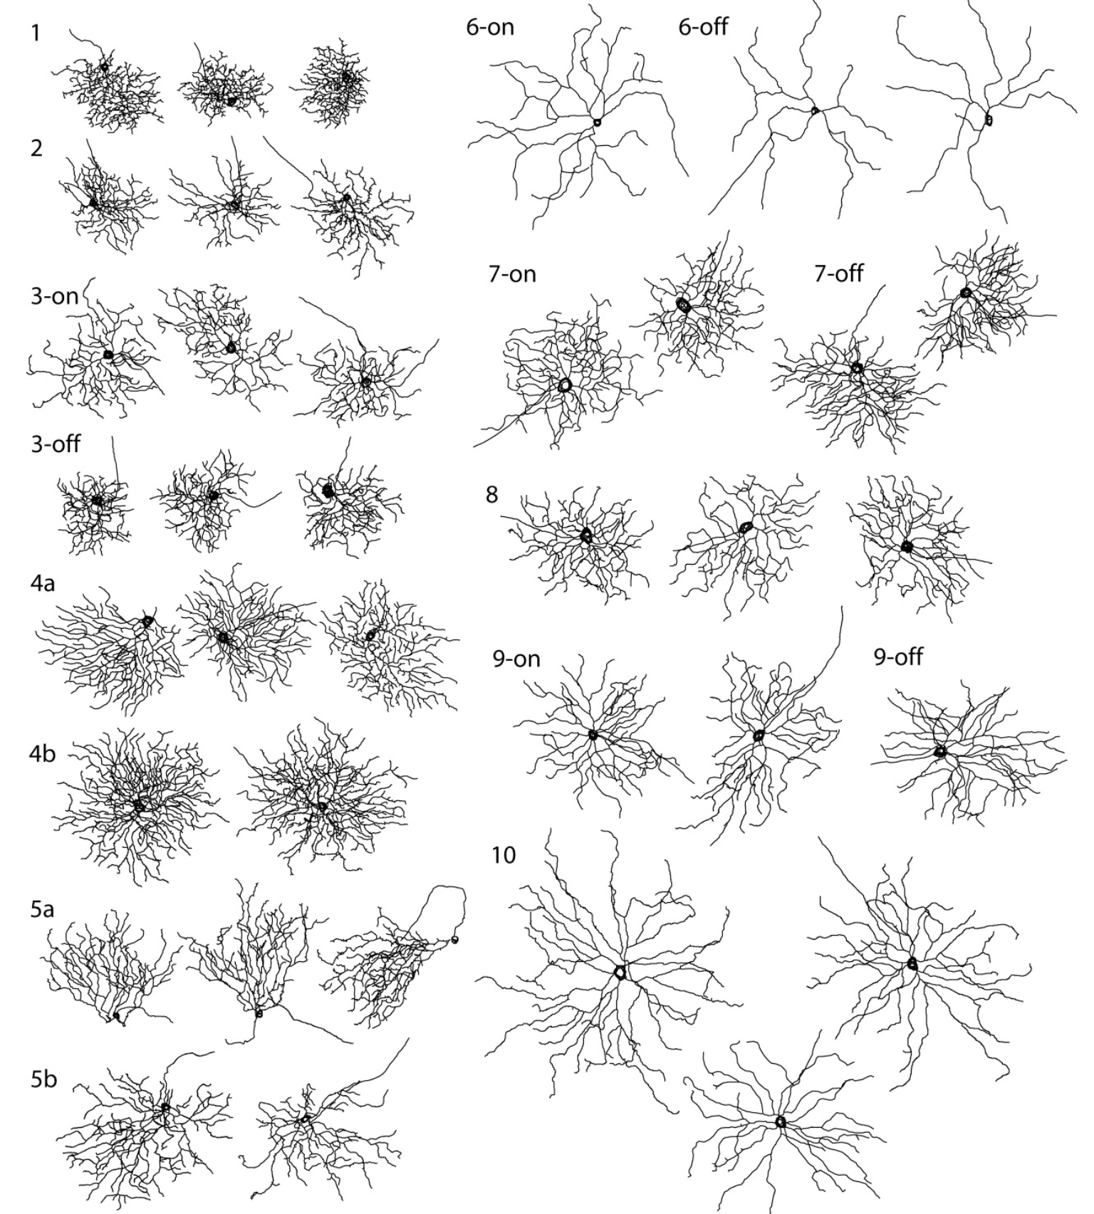
Retinal ganglion cells are further separated into many different cell types
What are the computational benefits of having so many cell types?

Slide 23
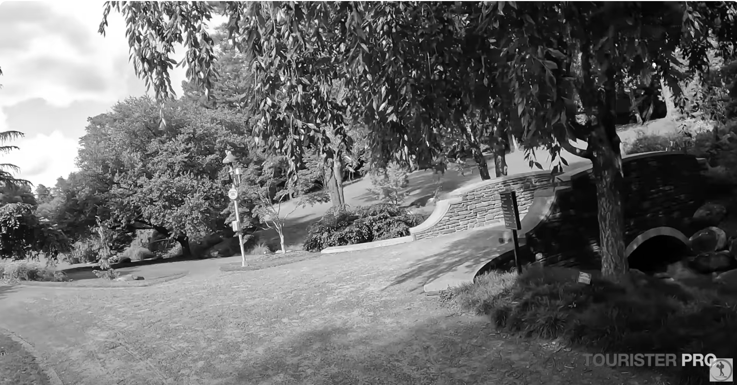

Color and motion are crucial aspects of visual scenes
Notes:
John: Don’t need this slide because midget cells encode color, and they are the most prevalent cell type

Slide 24
What can efficient coding tell us about retinal cell types?
Efficient coding predictions for color and motion are currently limited:
The predictions for color inputs currently do not have cell types, due to an infinite number of neurons and the absence of an output nonlinearity
The predictions for motion currently assume space-time separability, which excludes the possibility of direction-selectivity
If we had such predictions, we could explain how properties of RGCs emerge. For example, we could explain how aspects of natural images (e.g. optic flow) or the model (e.g. number of neurons) give rise to receptive fields with specific properties (e.g. direction selectivity).
Aim 1: Test whether the chromatic encoding of RGC types can be explained by efficient coding principles.
Aim 2: Expand efficient coding models to explain direction-selectivity in RGC

Slide 25
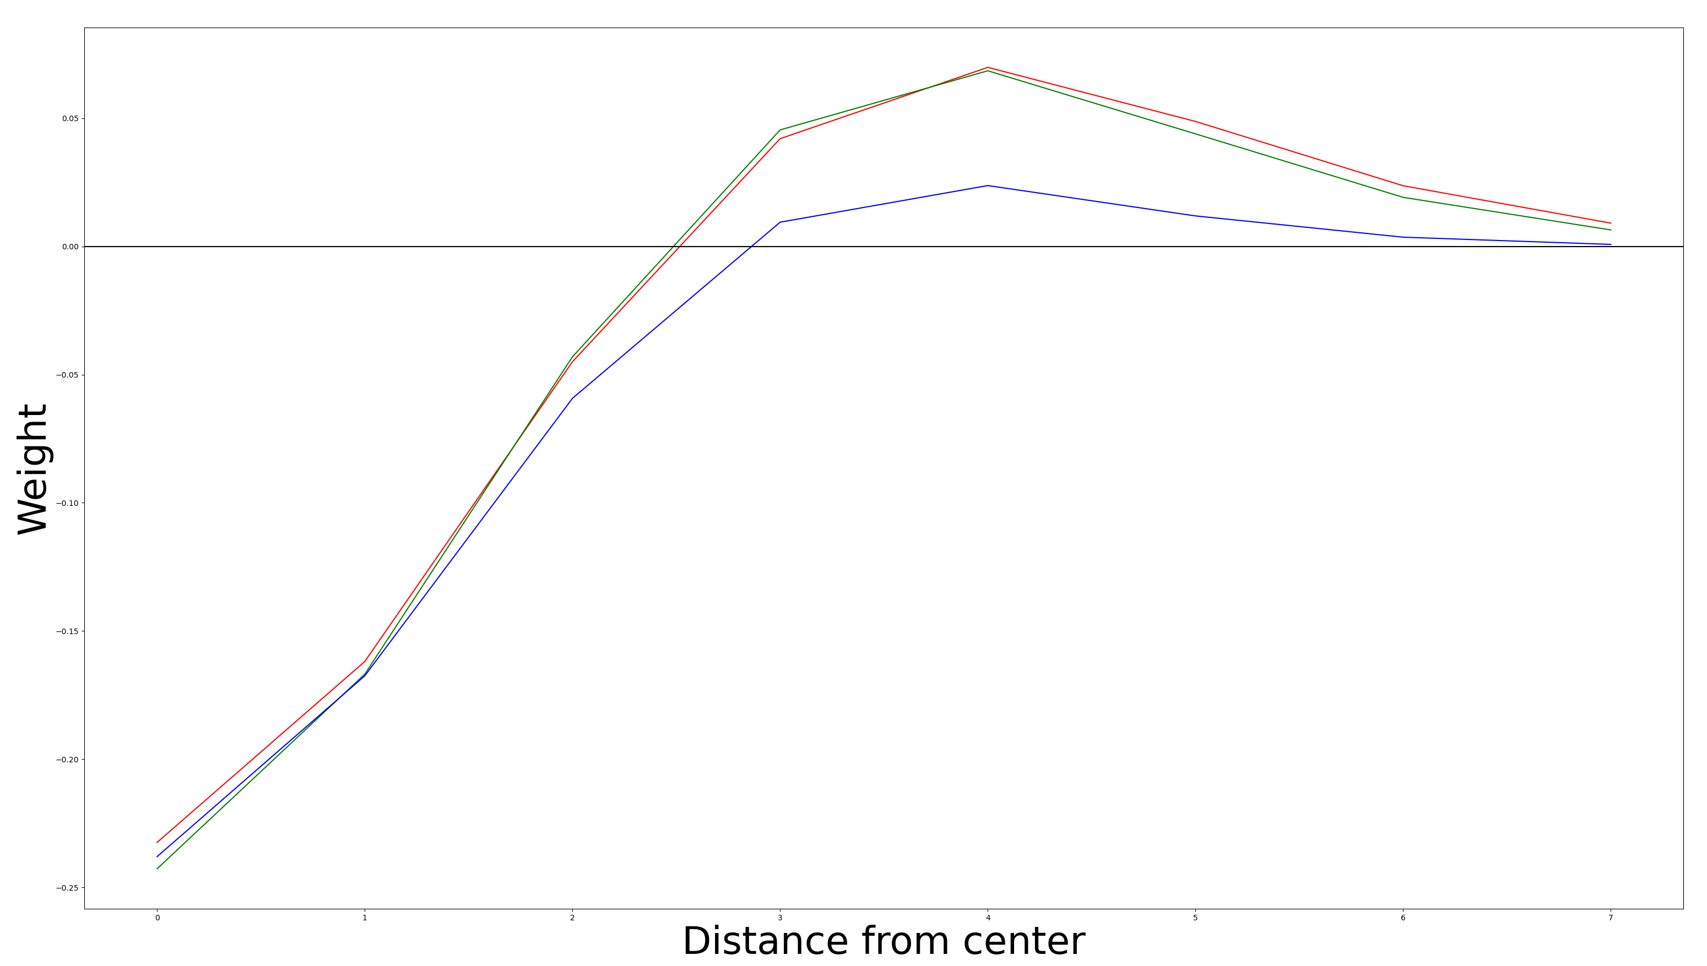
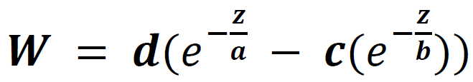
Difference-of-gaussian parametrization
Number of W parameters without DoG parametrization:
18 pixels x 18 pixels x 3 channels = 972
Number of W parameters with DoG parametrization:
4 parameters x 3 channels = 12

Slide 26
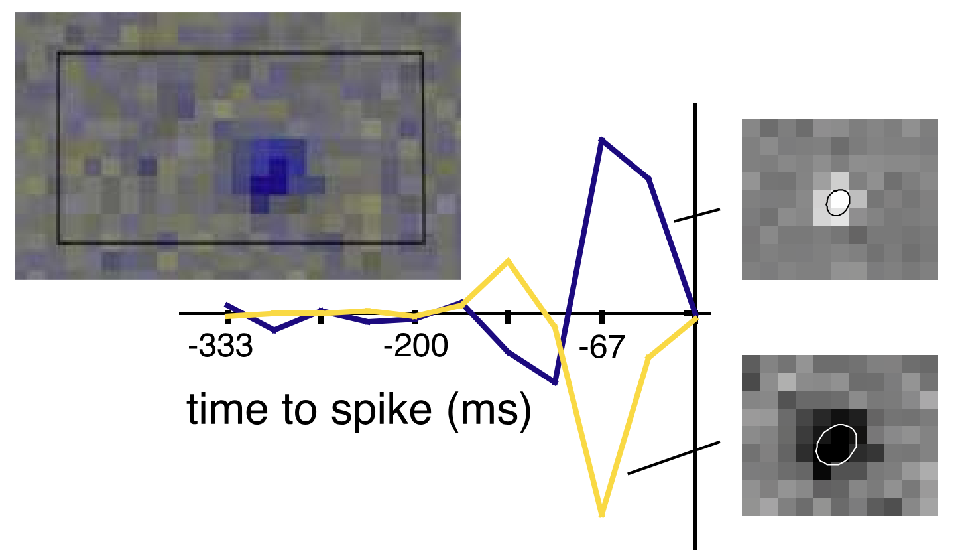
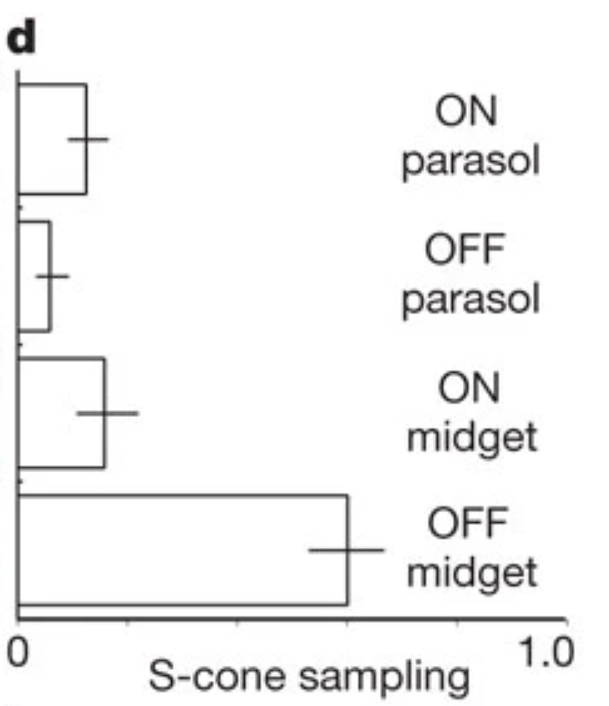
Small bistratified cells have an ON but not an OFF pathway
Bistratified receive +S and –L-M inputs
S OFF inputs instead project to OFF midget cells

Slide 27
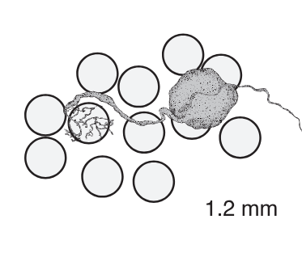
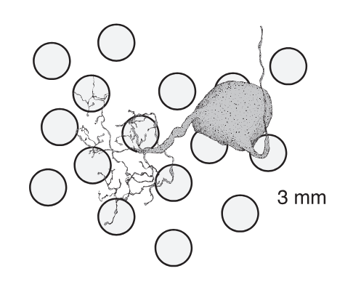
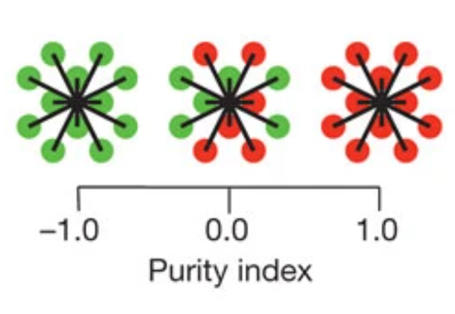
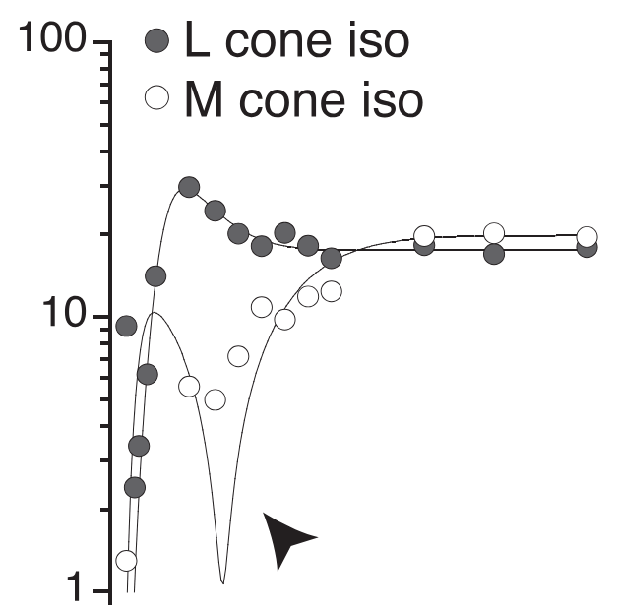
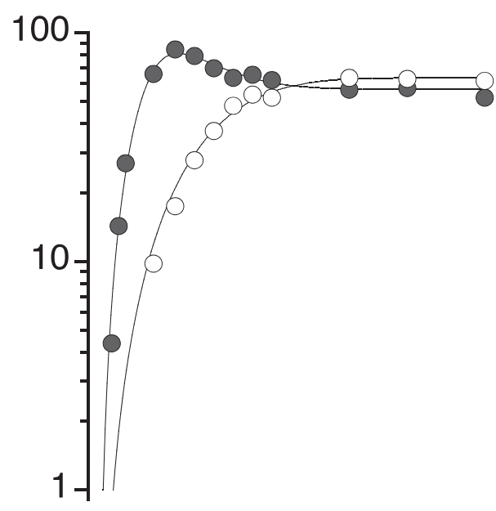
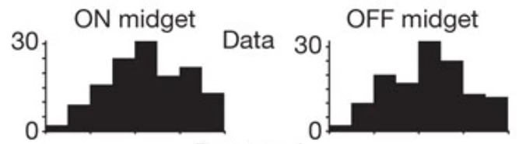

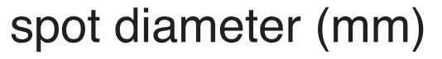
Midget cells have different receptive fields in the fovea and periphery
Fovea
Periphery
Periphery
Crook et al., 2011
Field et al., 2010

Slide 28
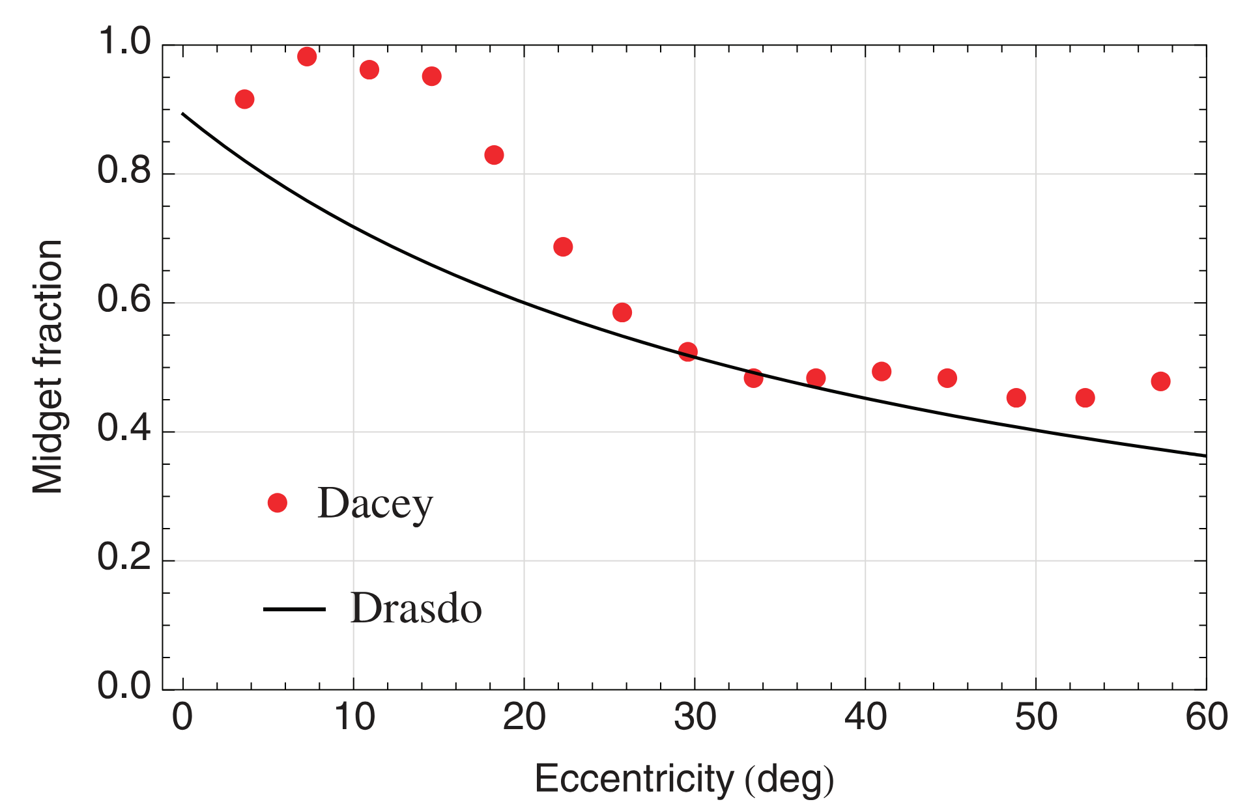
Proportion of RGCs that are midget cells goes down as eccentricity increases

Slide 29
Summary

Slide 30


Mosaics with 2 color channels

Slide 31
Future directions (move this to supplement)
1. Investigate in which circumstances, and on what theoretical grounds, neurons should be color- opponent or achromatic
2. Obtain consistent mosaics for with 3 color channels
3. Test the hypothesis that bistratified do not have an OFF pathway due to an asymmetry in the statistics of natural images
4. Test the hypothesis that increasing the number of neurons increases the proportion of midget cells and leads to red/green opponency.

Slide 32


ON-OFF DSGCs are direction-selective

Slide 33
Future directions
1. Train this space-time inseparable model on natural movies to obtain regular mosaics for every type
2. Increase the number of neurons, and/or change the statistics of natural movies, to obtain DSGCs
3. Experiment with different natural movie statistics to understand why ON-OFF DSGCs only encode the four cardinal directions

Slide 34
https://www.ncbi.nlm.nih.gov/pmc/articles/PMC8175861/

Slide 35

Why those cell types?
- We know about the physiology, but lack explanations
- It would be simple – but mistaken – to create a separate explanation for every known experimental finding
- Instead, we need organizational principles from which many properties of the physiology naturally emerges

Slide 36
Splitting information into ON and OFF pathways is efficient (TO REMOVE)
Gjorgjieva, Spompolinsky & Meister, 2014
Notes:
Remove this slide, I am trying to get to cell types

Slide 37






Efficient coding can replicate ON and OFF mosaics (TO REMOVE)
ON neuron
OFF neuron
Jun, Pearson & Field, 2021
Notes:
With limited cells, cells will specialize into cell types. We showed that cell types can emerge naturally which is really cool
Charge straight at the problem

Slide 38




Midget cells
Parasol cells
Low temporal frequency
High temporal frequency
High spatial frequency
Low spatial frequency

Slide 39


Slide 40


Slide 41
Direction-selectivity is due to asymmetric inhibition from starburst amacrine cells
Fried, Munch & Werblin, 2002

Slide 42

S-OFF cones instead project onto OFF midget cells (TO REMOVE)
Field et al., 2010

Slide 43
Explain what
Explain what we understand from these models
What do we learn if we get DSGCs?
I can answer how questions. How does this emerge?
Part 2:
We don’t know what the predictions are from this theory, from these inputs.
Ps: Fitting these models is not trivial
Parrt 3: The straightest line from cell types to EC is Nayoung’s second paper.
SHOW MOVIE!!!

Slide 44


